Slide 1
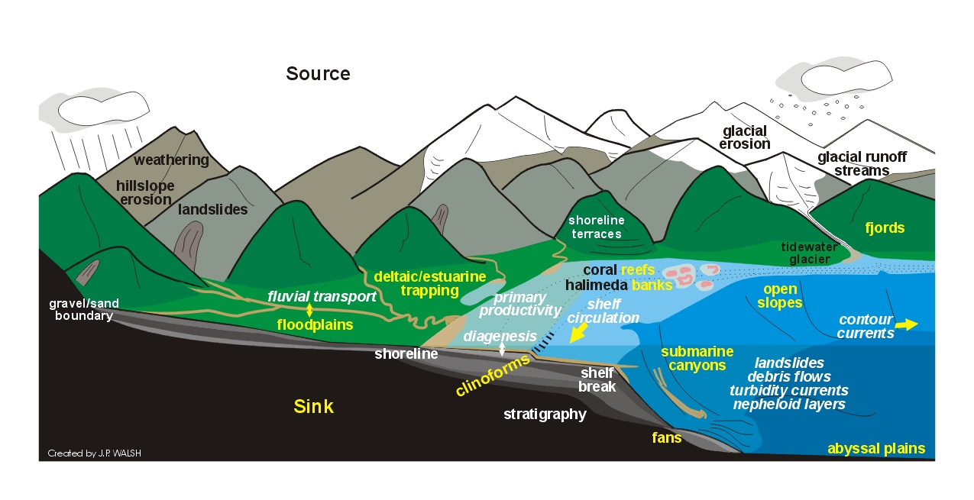
Soils

Slide 2
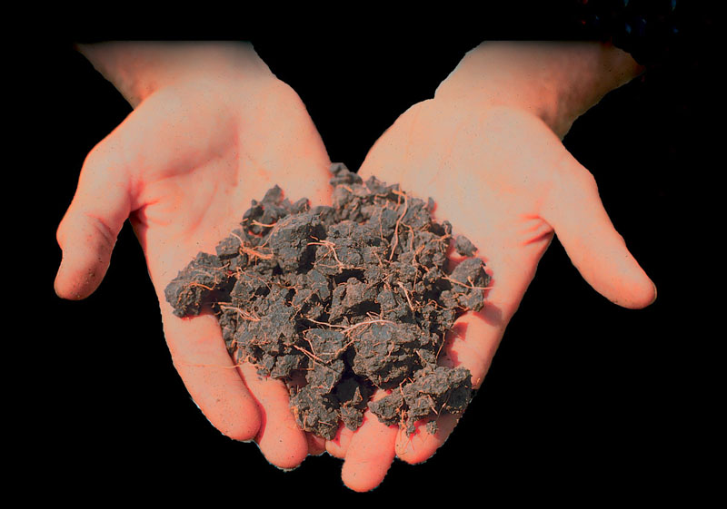
Soils
We know more about the movement of celestial bodies than about the soil underfoot.
- Leonardo da Vinci
Notes:
We continue our discussion of weathering by examining what happens to weathered products; the production of soils!

Slide 3
Soil: Definition
Solid earth material that has been altered by physical, chemical and organic processes so that it can support rooted plant life.
Engineering definition: Anything that can be removed without blasting

Slide 4
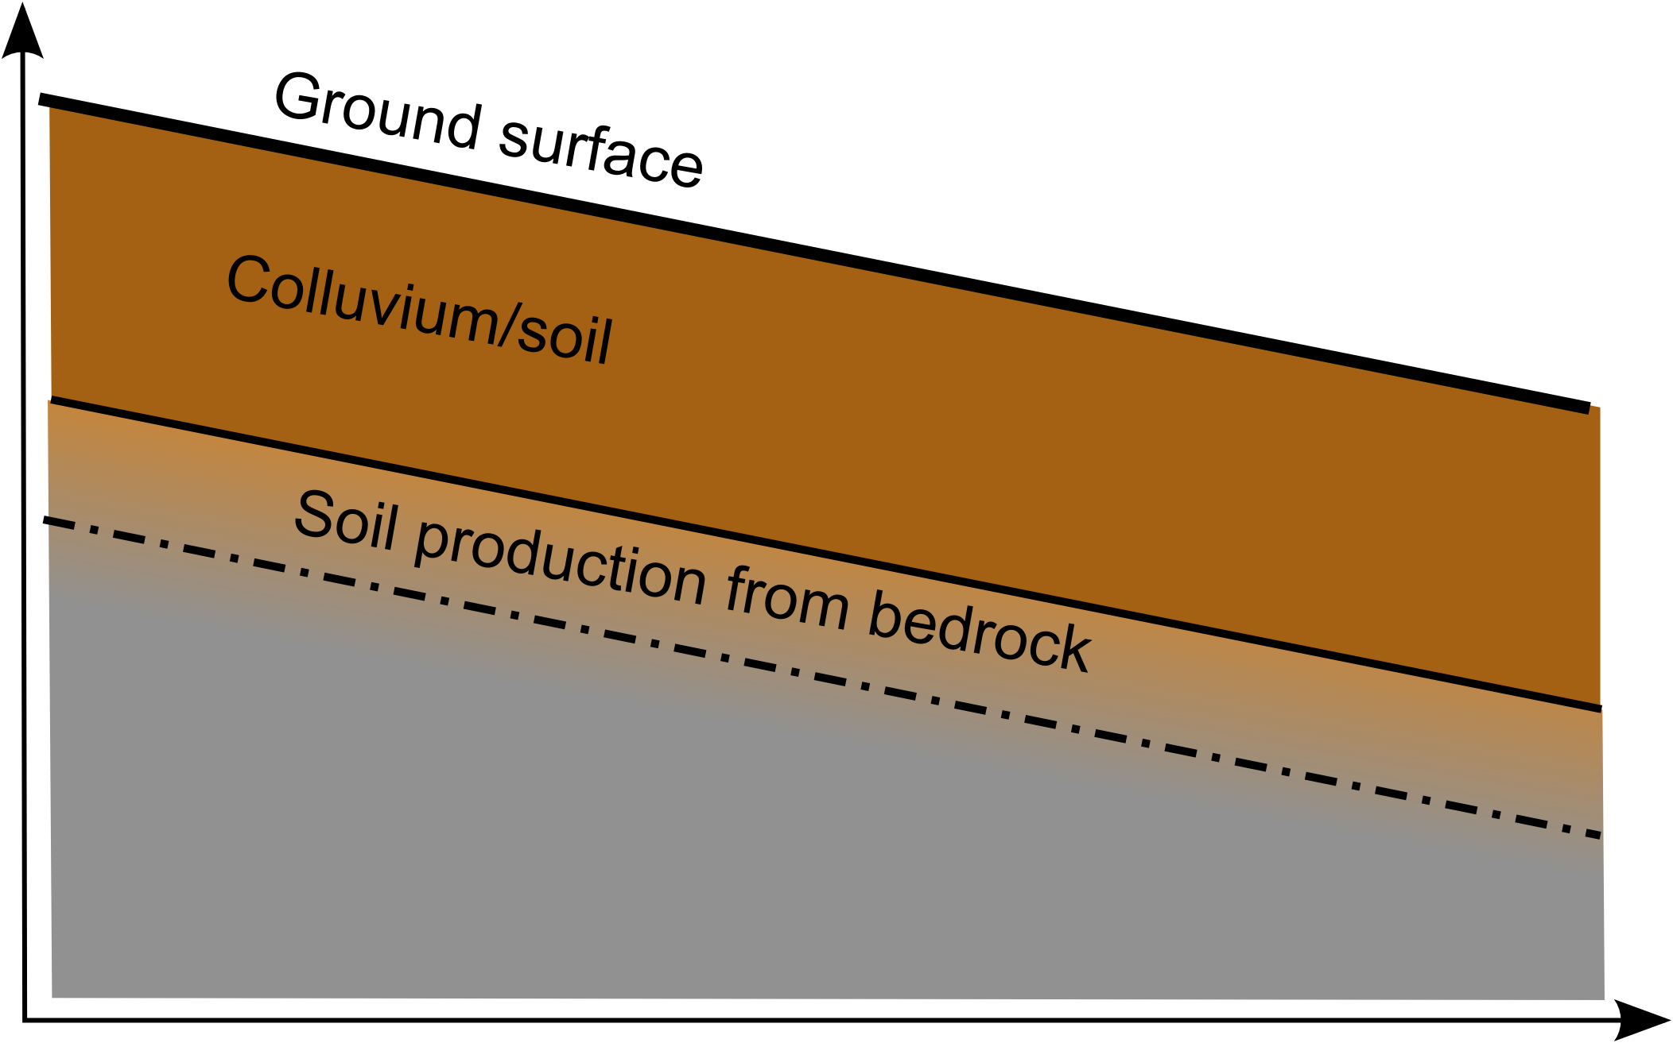
Soil Production
Notes:
A soil profile

Slide 5
Soil Production: inputs
Conversion of rock to soil
Notes:
Soil is added from the bottom up; unlike many other deposits and features of the natural world!

Slide 6
Soil Production: outputs
Downslope movement of soil
Notes:
Soil can then be removed from a slope through downslope movement, driven by gravity and helped along by natural processes.

Slide 7
Soil Thickness: Storage
input ± output = soil thickness
or: rock conversion ± soil transport = thickness
that is, soil thickness reflects the balance between rates of soil production and rates of downslope soil movement.

Slide 8
Factors of Soil Formation
Notes:
What factors might influence the rates of soil formation?

Slide 9
Factors of Soil Formation
Climate
Organisms
Parental Material
Topography
Time

Slide 10
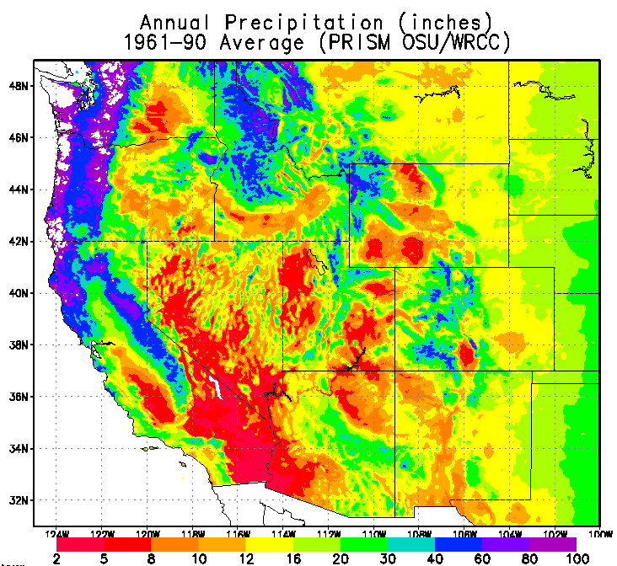
Factors of Soil Formation
Climate
Organisms
Parental Material
Topography
Time
Notes:
Wetter climates are going to result in more rapid soil formation and transfer of soils, as well as transfer of material within a soil

Slide 11
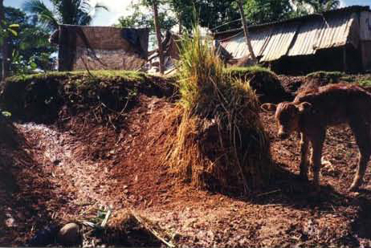
Factors of Soil Formation
Climate
Organisms
Parental Material
Topography
Time
Notes:
Some obvious effects here of degradation, but organisms can also aid soil development, as earthworms do. They also add organic matter which can enrich soils and provide needed nutrients.

Slide 12
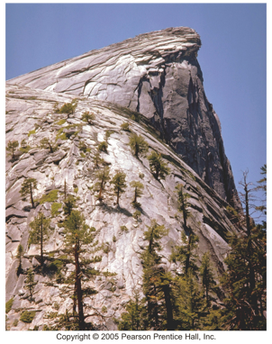
Factors of Soil Formation
Climate
Organisms
Parental Material
Topography
Time
Notes:
Soils are mostly composed of degraded bedrock, so it makes sense that the chemistry of the bedrock is going to be important in determining soil characteristics. Rock strength and fracture density will also control rates of soil formation

Slide 13
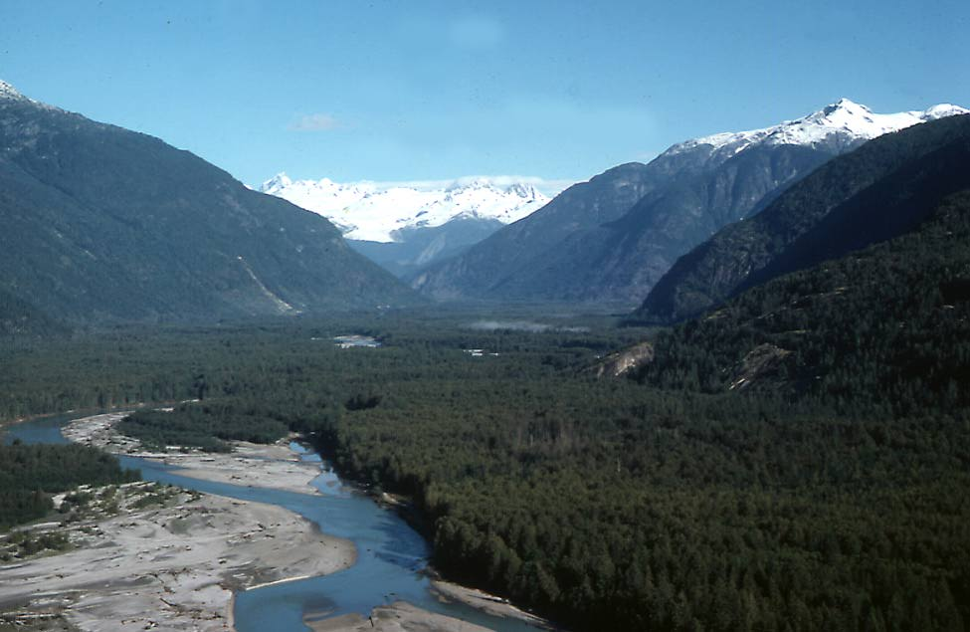
Factors of Soil Formation
Climate
Organisms
Parental Material
Topography
Time
Notes:
Topography will largely control where/how soil moves. Steep slopes will have more gravitational potential energy, and result in more movement of soil off the slope, hence thinner soils. But downslope in hollows and flat plains, that soil can accumulation and form thicker deposits that do not get transported away. Topography will also help control the local climate and accumulation of rainwater, for example, as well as organisms.

Slide 14
Factors of Soil Formation
Climate
Temperature and precipitation
Indirect controls (e.g., types of plants)
Weathering rates
The greater the rainfall amount, the more rapid the rate of both weathering and erosion.
Notes:
Based on this map of precipitation rates, is soil production likely to be higher in western or eastern Washington?

Slide 15
Factors of Soil Formation
Organisms
Types of native vegetation
Weathering is dependent of plant growth
Plant and animal activity produces humic acids that are powerful weathering agents. [acids derived from chemical breakdown of organic matter]
Plants can physically as well as chemically break down rocks.
Plants stabilize soil profiles, Animals (including humans) tend to increase erosion.

Slide 16
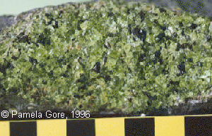
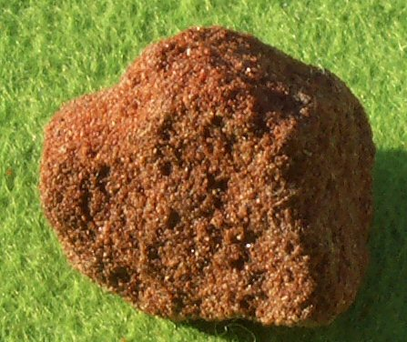
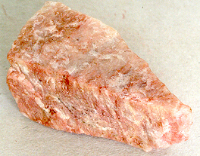
Factors of Soil Formation
Parent Material
Chemistry
Mineralogy
Grain size

Slide 17
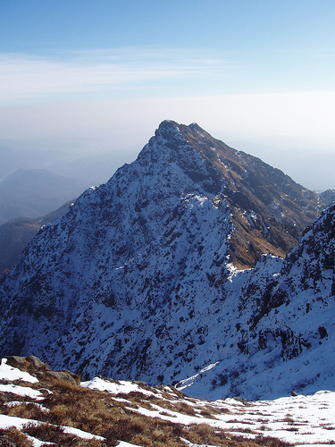
Factors of Soil Formation
Topography
Ground slope
Elevation
Aspect (north vs. south facing slopes)

Slide 18
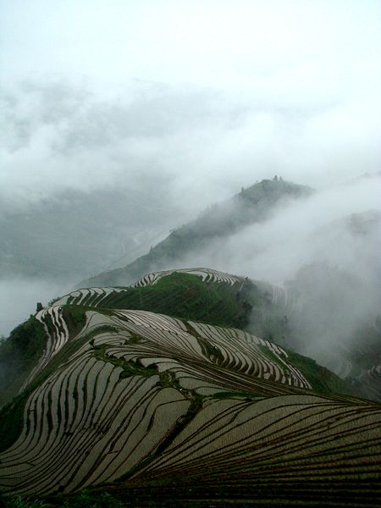
Factors of Soil Formation
Downslope transport of soil is a function of slope:
Erosion rate = f(S)
Steeper slopes erode faster.
The steeper the surface slope, the more likely any eroded material is to be transported out of the system.

Slide 19
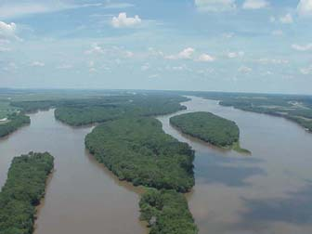
Factors of Soil Formation
Soils on hillslopes reach an equilibrium thickness, often about 1m.
Soils on flat surfaces, such as floodplains or plateaus, tend to thicken through time due to weathering rates being greater than sediment transport rates.

Slide 20
Factors of Soil Formation
Time for development and destruction of soil profiles
Typical chemical reaction rates are slow → the longer a rock unit has been exposed, the more likely it is to be weathered
And, the longer soil waits before transport, the thicker it can become…

Slide 21
End of 10/6 and start of 10/13

Slide 22
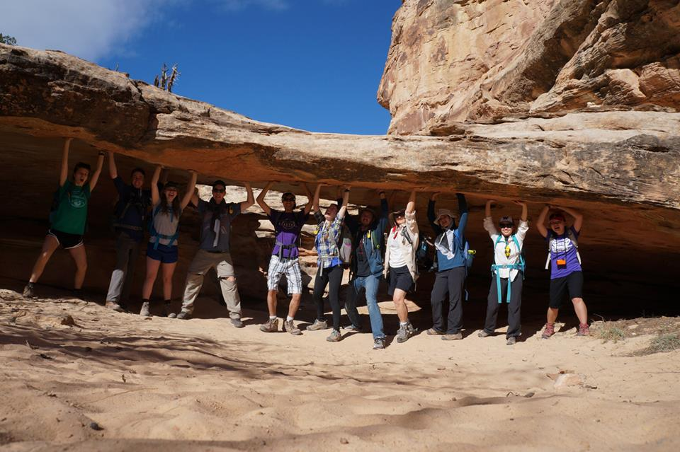
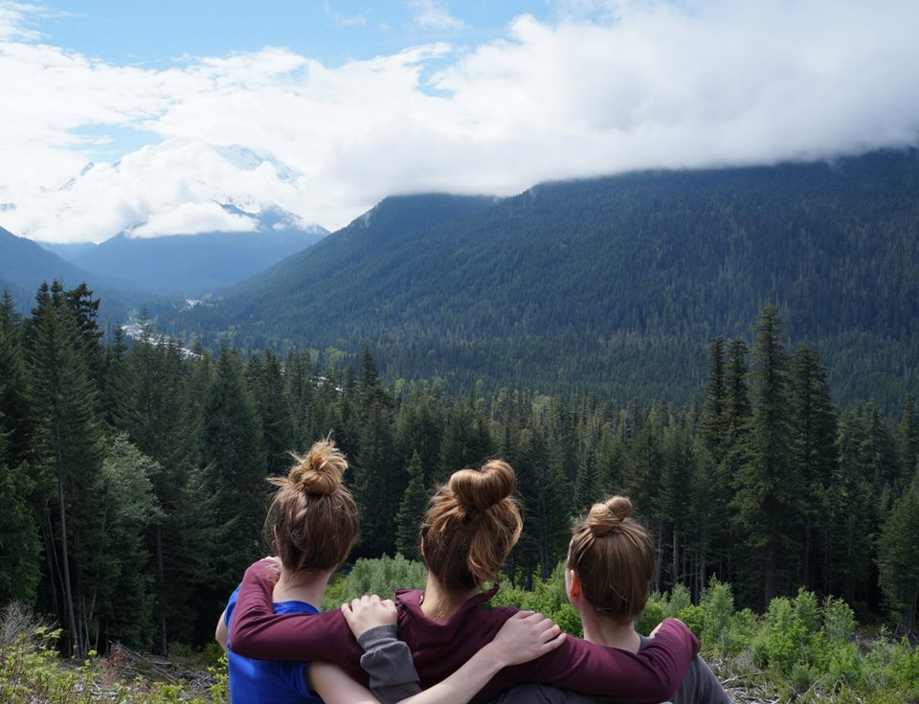
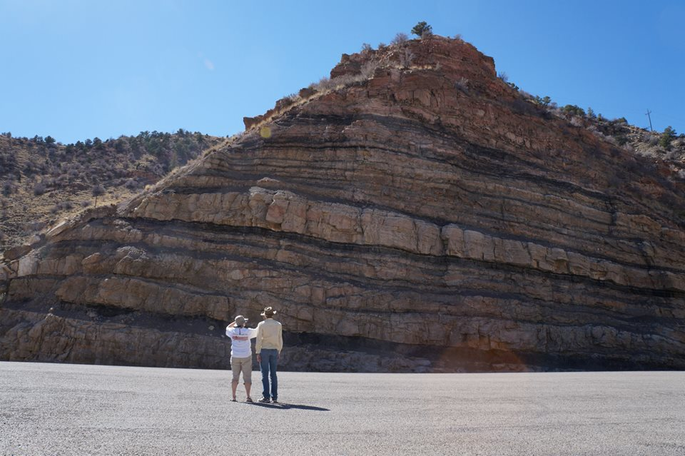
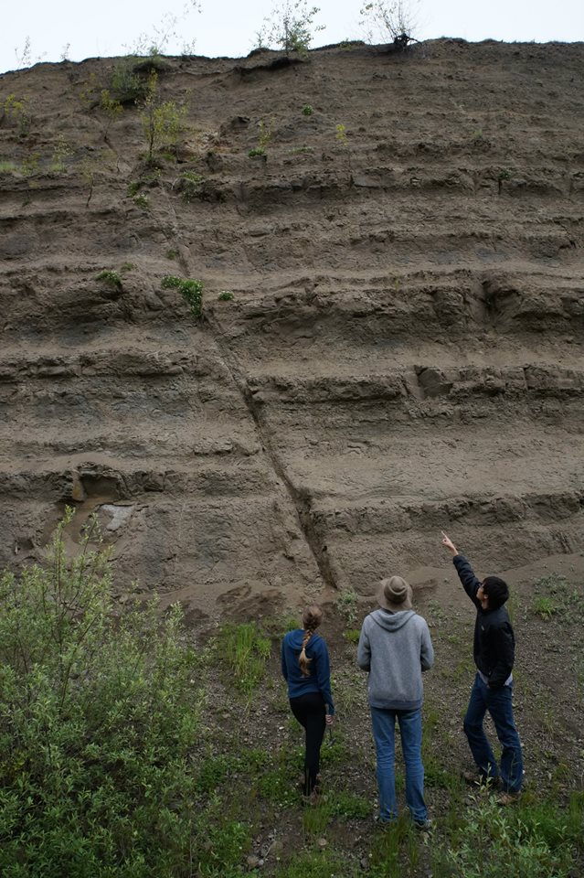
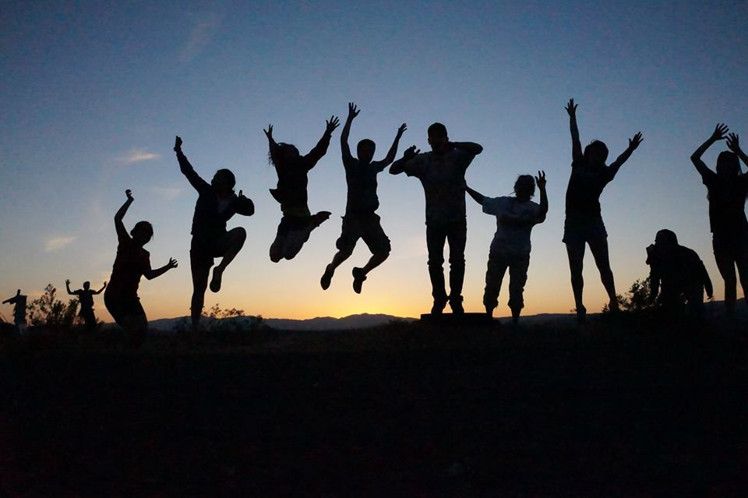
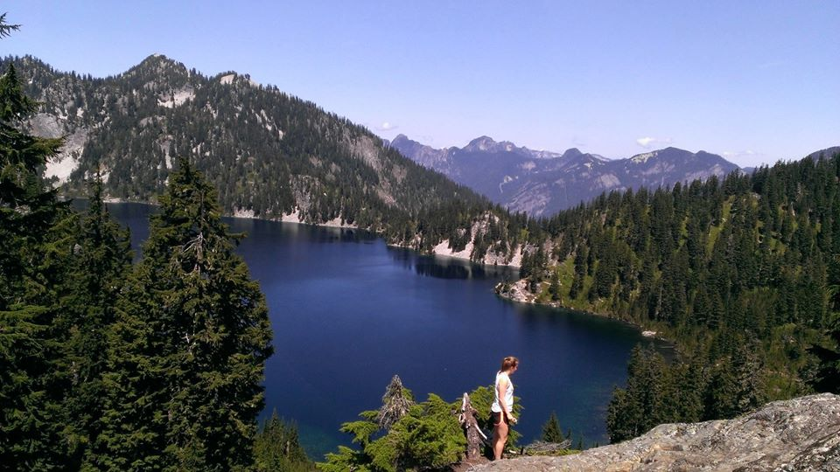
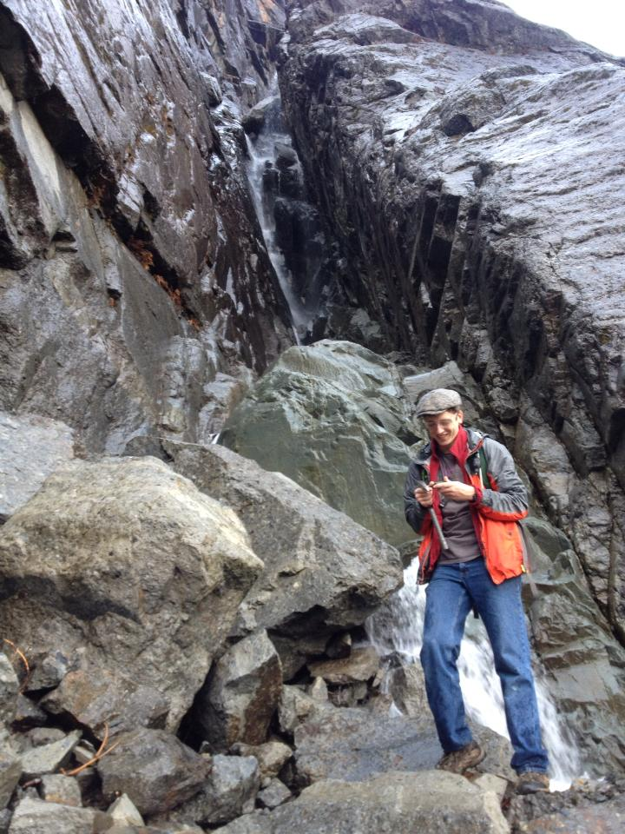
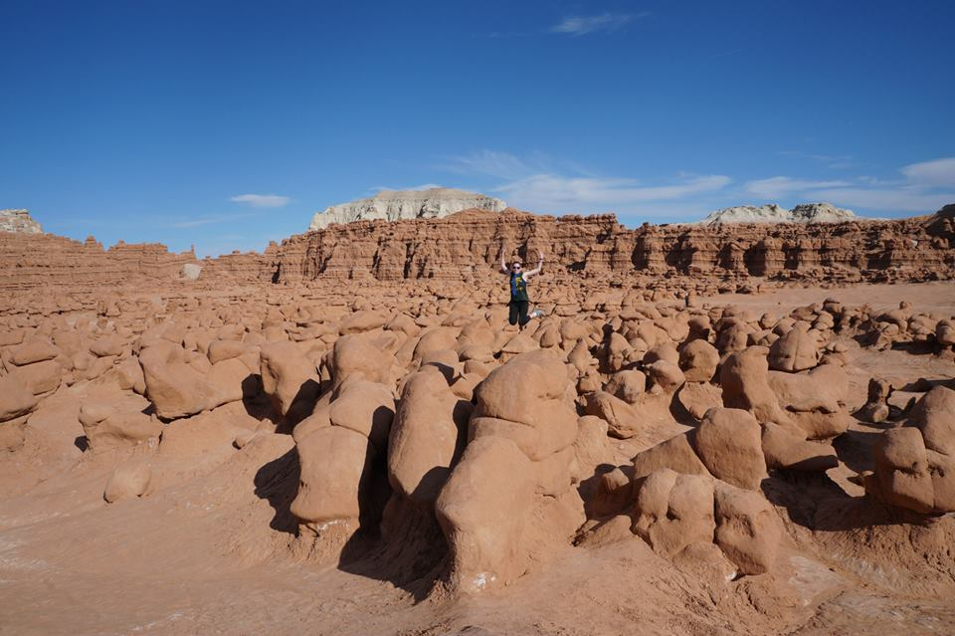
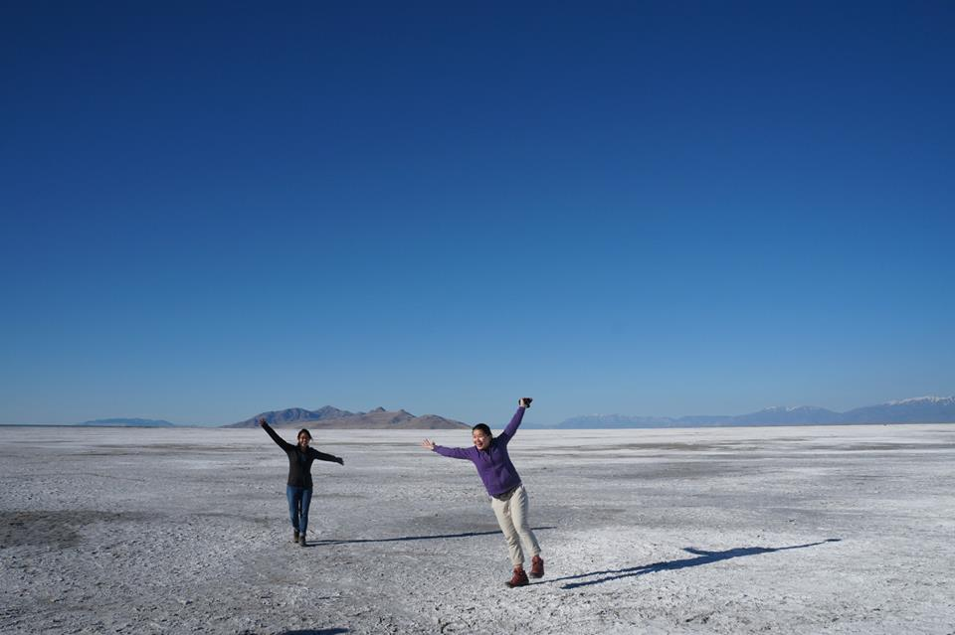
GeoClub! #1 in Friendship and Geology!
Email: essgeoclub@gmail.com
Facebook: UW ESS GeoClub

Slide 23
Factors of Soil Formation
Climate
Organisms
Parent Material
Topography
Time
Downslope movement of soil
Conversion of rock to soil

Slide 24
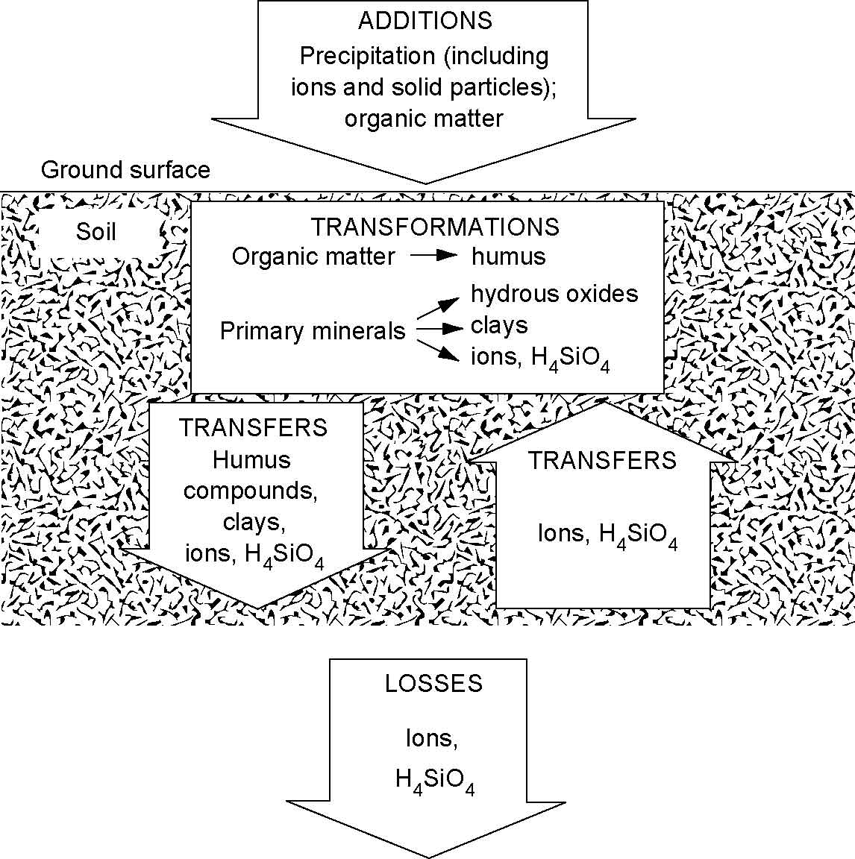
Processes of Soil Development
combined effects of:
additions to ground surface
chemical transformations
vertical transfers
removals from soil
Relative importance varies
Notes:
Left off here

Slide 25
Additions to soils
Inputs from outside ecosystem
Atmospheric inputs
Precipitation, dust, deposition
Horizontal inputs
Floods, tidal exchange, erosion, land-water movement
Inputs from within ecosystem
Litterfall and root turnover

Slide 26
Transformations
Decomposition of organic matter
Breakdown to form soluble compounds that can be absorbed and leached away
Depends on input quantity, location (roots, leaves), environment (temp & precip)
Humification to form complex organic matter
Weathering of rocks
Physical weathering / fragmentation of rock
Freeze-thaw; drying-wetting; fire
Chemical weathering
primary → secondary minerals

Slide 27
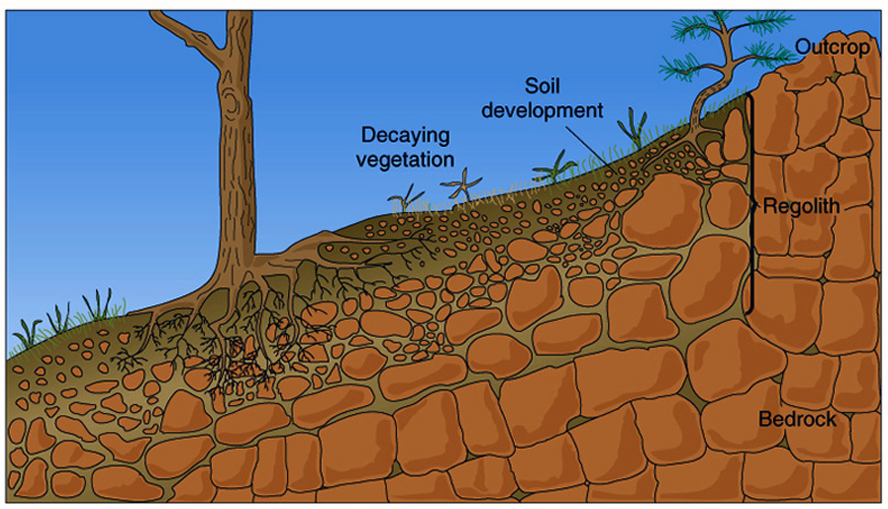
Parent material (bedrock) undergoes weathering to become regolith (soil + saprolite).
Regolith

Slide 28
Soil is a mixture of mineral and organic matter lacking any inherited rock structure.
Soil

Slide 29
Saprolite is weathered rock that retains remnant rock structure.
Saprolite

Slide 30
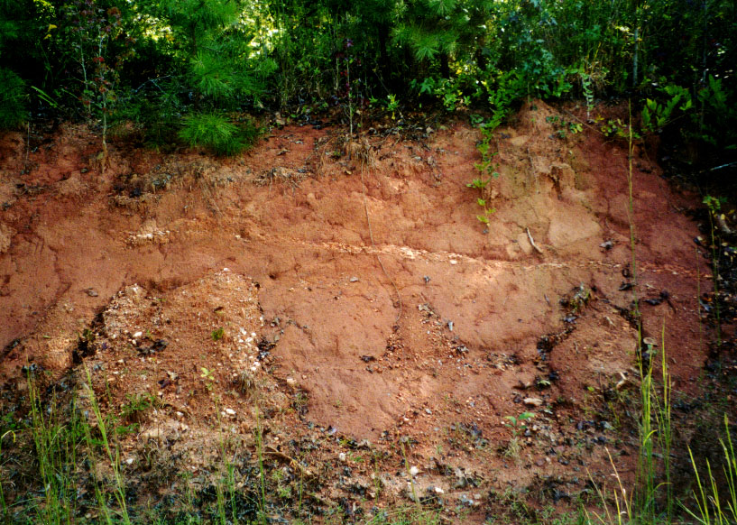
Saprolite

Slide 31
Soil Horizons and Profiles
Soil Horizons
Over time, soil layers differentiate into distinct ‘horizons.’
Not deposited, but zones of chemical action:
Chemical reactions and formation of secondary minerals (clays).
Leaching by infiltrating water (elluviation)
Deposition and accumulation of material leached from higher levels in the soil (illuviation)
“Soil Profile”
-Suite of horizons at a given locality

Slide 32
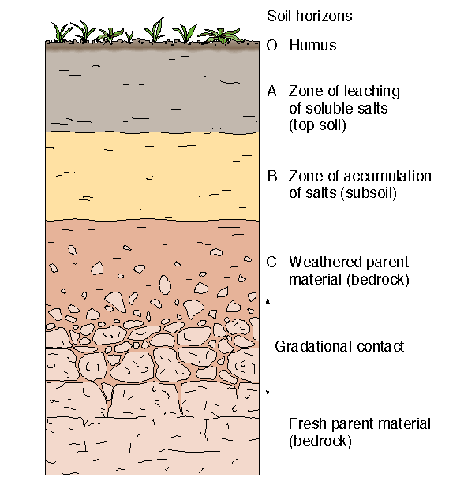
Typical soil profile

Slide 33
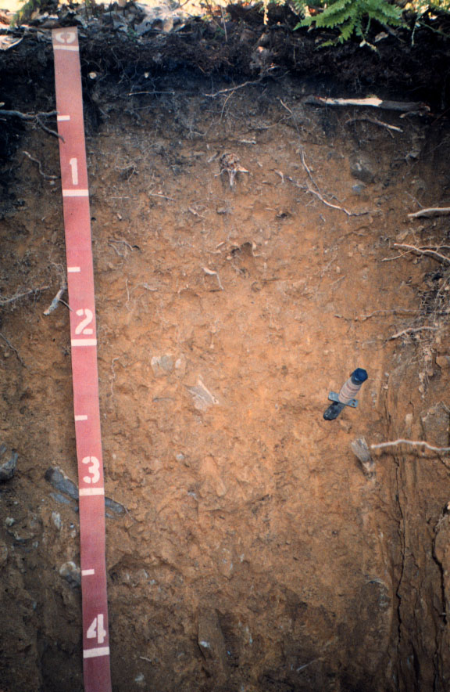
Cookport soil, Pennsylvania
A Horizon
B Horizon
C Horizon

Slide 34
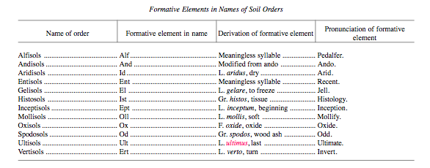
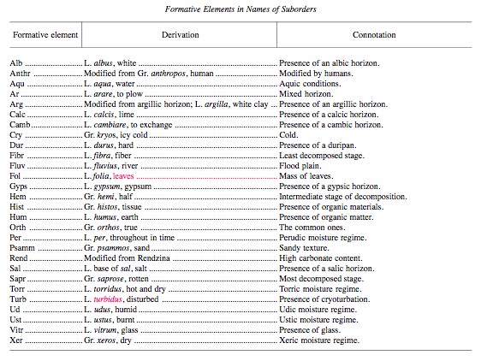
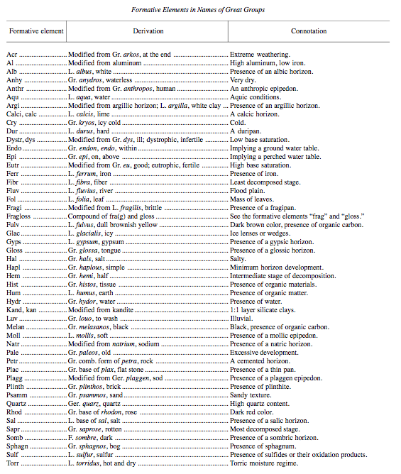
Soil classification = messy

Slide 35
Soil classification = soil orders
Aridisols = arid zone soils (calcic horizons)
Mollisols = grassland soils (thick A horizon)
Alfisols, Ultisols, and
Spodosols = forest soils (thick B horizon)
Oxisols = tropical soils (quite oxidized)
Histosols = wetland soils
Gelisols = polar soils
Andosols = volcanic parent material
Vertisols = swelling clays
Entisols = weak A over C horizon
Inceptisols = weak B horizon

Slide 36
Soil classification = soil orders
Aridisols = arid zone soils (calcic horizons)
Mollisols = grassland soils (thick A horizon)
Alfisols, Ultisols, and
Spodosols = forest soils (thick B horizon)
Oxisols = tropical soils (quite oxidized)
Histosols = wetland soils
Gelisols = polar soils
Andosols = volcanic parent material
Vertisols = swelling clays
Entisols = weak A over C horizon
Inceptisols = weak B horizon

Slide 37
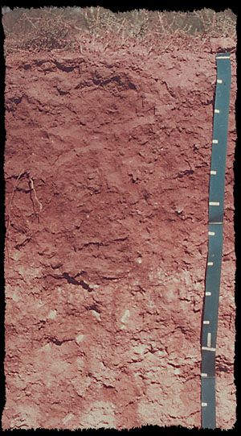
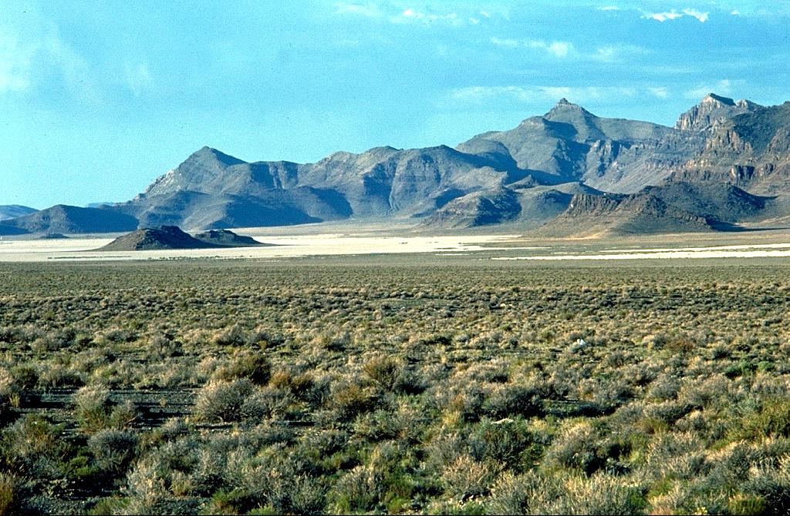
Soil types (more simply) – Aridisols
Physical weathering breaks rocks into small mineral particles.

Slide 38
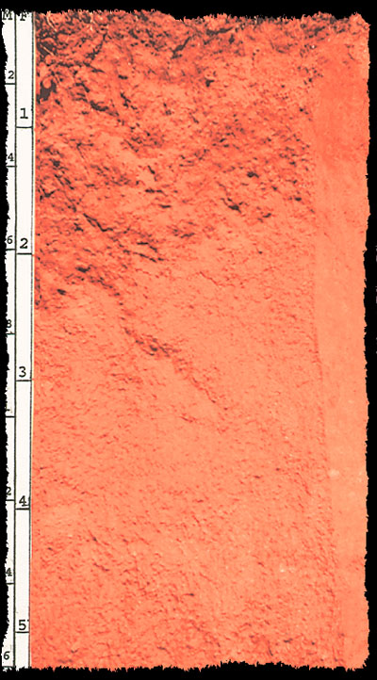
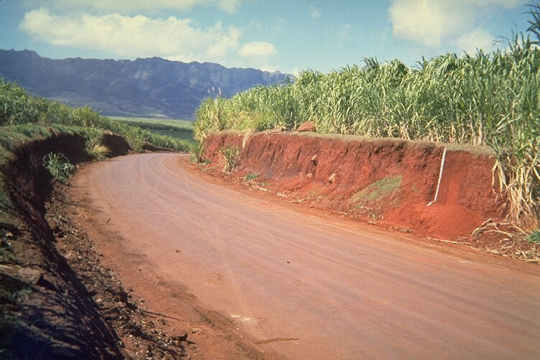
Soil types – Oxisols
Chemical weathering dissolves and changes minerals at the Earth’s surface.

Slide 39
Decomposing organic material from plants and animals mixes with accumulated soil minerals.
Soil types – Mollisols

Slide 40
Limits on soil development
Balance between:
Downward lowering of ground surface
Downward migration of soil horizons
If erosion is rapid or soil evolution slow, soils may never mature beyond a certain point
Extremely ancient soils may have lost everything movable

Slide 41
Rates of Soil Development
U.S. Department of Agriculture estimates that it takes 500 years to form an inch of topsoil.
That’s less than 0.01 mm yr⁻¹!!
Modern rates of soil loss are 100 to 1000 times rates of soil formation (typically > 1 mm yr⁻¹ in agricultural settings).
Sets up a fundamental problem due to the erosion of natural capital!

Slide 42
Soil and the Life-Cycle of Civilizations
How long would it take to erode a 1m-thick soil?
Thickness of soil divided by the difference between rate of soil erosion and production.
$\frac{1 m}{\left(1.00\frac{mm}{yr}\right)−\left(0.01\frac{mm}{yr}\right)}=1000 yr$
This is about the life-span of most major civilizations...
1.0
1000
1.0
0.01

Slide 43
Man—despite his artistic pretensions, his sophistication, and his many accomplishments—owes his existence to a six-inch layer of topsoil and the fact that it rains.
- Author Unknown

Slide 44
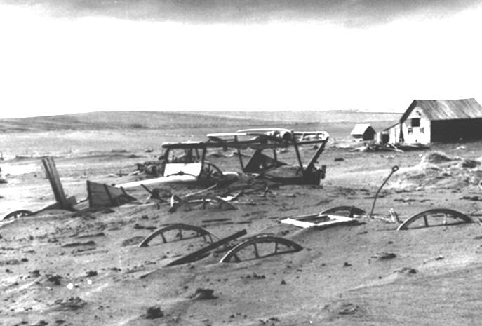
A nation that destroys its soils, destroys itself.
– President Franklin D. Roosevelt, Feb. 26, 1937.
National Archives: 114 SC 5089

Slide 45
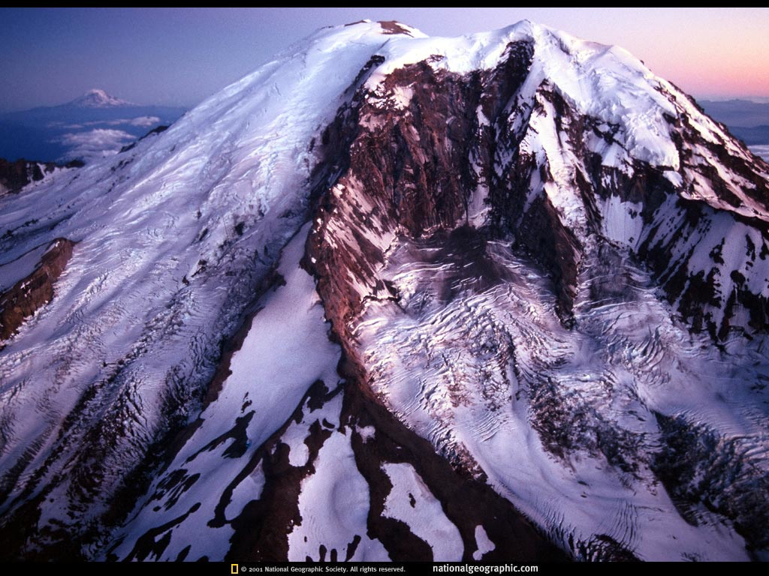
and finally
sign up for field trip A1 or A2 by 5pm TODAY!
On Friday of next week we will discuss erosion
how to get rid of the materials created by physical & chemical weathering and soil formation…

